Slide 1
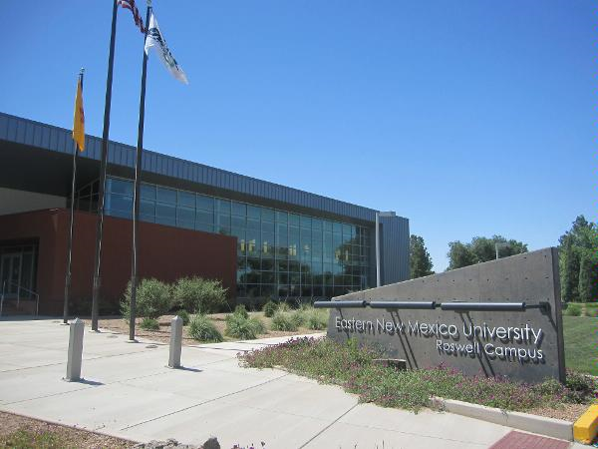
Eastern New Mexico University-Roswell
Special Services Program
P.O. Box 6000 Box 282
Roswell, New Mexico 88202
Phone: (575) 624-7286
Fax: (575) 624-7350

Slide 3
Success starts here!
Our career training allows students to learn marketable vocational skills, as well as practical life and independent living skills. We pride ourselves on the average 79% employment placement of graduates. Graduates leave our campus with a Certificate of Occupational Training, valuable life experiences, and positive personal growth.

Slide 4
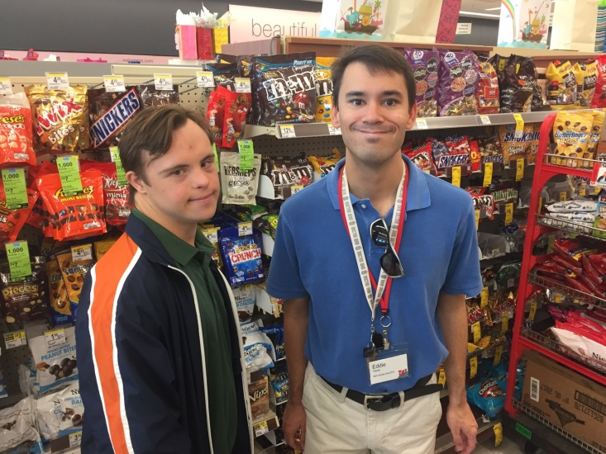
Program Overview
The Special Services program is a consecutive 3 semester, 11 month, 50 credit hour (first year) and 48 credit hour (second year and beyond) Occupational Training program. Upon successful completion of the program, students earn a Certificate of Occupational Training (COT) in their chosen discipline.
Our training program emphasizes hands-on instruction (on-campus classroom, lab, and off-campus practicum experiences) while enhancing independent living skills.

Slide 5
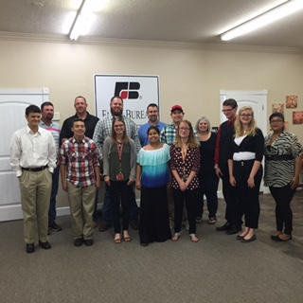
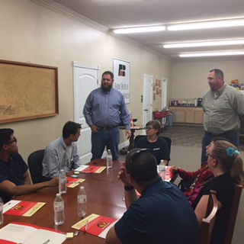
Program Details
All of our programs are designed for people who have disabilities, but whom, with occupational training, are able to obtain entry level positions in competitive employment.
Accommodations are embedded within our program: small class sizes (no more than 12 per class) and small group tutoring provided. Personal 1:1 tutors are available at the student’s expense (classroom can be provided upon request).

Slide 6
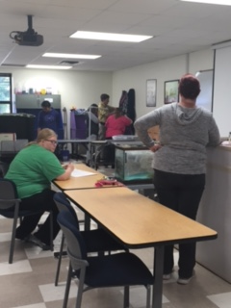
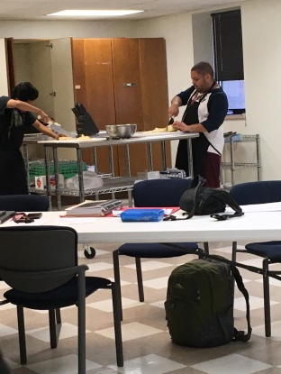
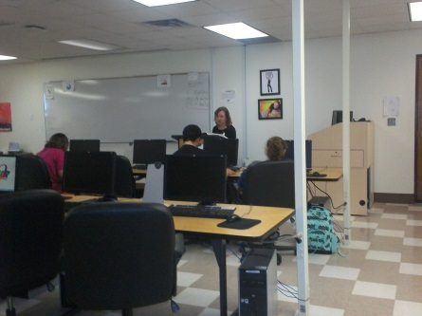
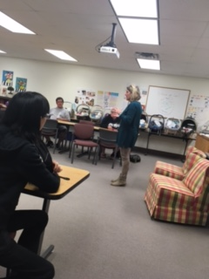
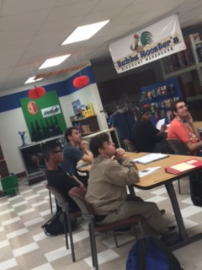
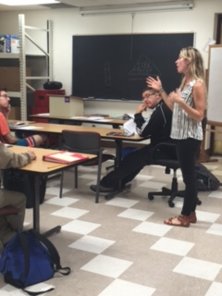
Vocational Areas of Study
Students choose a technical area of study (major). The technical skills taught in each career field prepares the student for entry level competitive employment in that discipline.
Animal Health Care
Building Maintenance
Child Care Attendant
Food Services
Office Skills
Stocking & Merchandising
Notes:
*Child Care Attendant–how to care for and work with infants and small children. Practicum sites: daycares, elementary schools.
*Food Services – how to work in a restaurant setting and be a prep cook. Practicum sites: local restaurants, bakeries, delis.
*Animal Health Care–how to restrain small animals, basic grooming and care, nutrition, maintain environment. Practicum sites: local zoo, grooming shops, Roswell Humane Society.
*Stocking and Merchandising–how to work in a retail setting, customer service, stock shelves, rotate merchandise. Practicum sites: Walgreens, Ace Hardware, Factory 2-U, convenience stores.
*Office Skills – how to file, alphabetize, answer phones, use computers, type documents. Practicum sites: hospitals, campus office, veterinary clinics, law offices, doctors offices.

Slide 7
Community Practicum Locations School year 19-20
Special Thanks to All Community Practicum Locations:
Big Lots, College Garden Animal Hospital, Country Club Animal Hospital, ENMU-Roswell: Aviation, Child Development Center, College Development Center, Great Western Dining Cafeteria, Library, Security, Special Services Administration Office, Student Services, Fairfield Inn Marriott, Farmer’s Country Market North, Harvest Ministries, Kelly Cassels/Joni Sterrett-Sanders Law Firm, Los Pasitos Preschool & Day Care, Lykins Tire, Mark Taylor Law Firm, New Mexico Military Institute-Sodexo Cafeteria & Stock Rooms, O’Reilly Auto Parts North & South, Roswell Animal Control, Roswell Humane Society, Salvation Army Family Store, Scruffy to Fluffy, Shamrock Foods, Sierra Vista Village Office, Spring River Zoo, Pecos Flavors Bistro & Winery, Valley View Elementary School, Walgreen’s North & South, Westlake ACE Hardware, Wildlife Safari Animal Emporium, Inc., Rains Surveying Company, Martin’s Capitol; Country Club Church of Christ, TownPlace Suites by Marriott, Parkview Elementary, Community Kitchen, Stellar Coffee, Peachtree Retirement Village

Slide 8
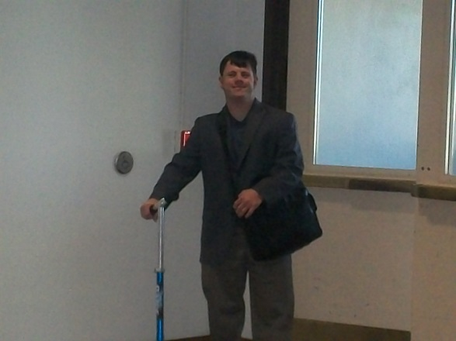
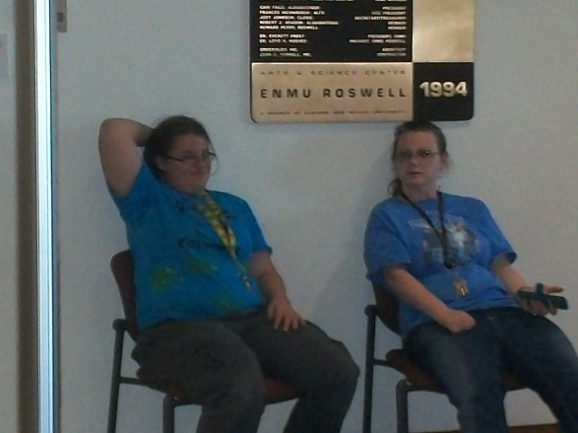
Core Requirements
Independent Living
Life Skills
Job Skills
Conflict
Adaptive P.E.
Community CPR and Standard First Aid (required for first year students)
Notes:
*Independent Living – learn how to make decisions that affect one's life and pursue activities of one's own choosing.
*Life Skills – learn how to make the most out of life; takes place in a dorm room setting.
*Job Skills – learn how to obtain a position and characteristics of being a good employee.
*Conflict – learn how to deal with day-to-day conflicts and difficulties.
*Adaptive P.E. – learn about the body, how to take care of it, and stay in shape.
*Community CPR and Standard First Aid (required for first year students)

Slide 9
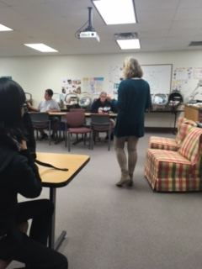
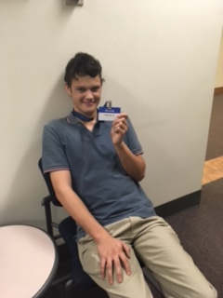
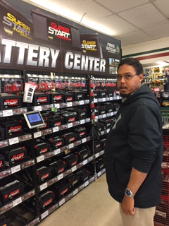
Technical Requirements
Each class has a lecture (learn the information), lab (practice the skills in a controlled environment), and a practicum (generalize the skills in a community setting).
Students work in a practical setting (unpaid practicum) within the community to utilize the skills they are learning in the classroom environment.
Practicums range from 15-20 hours per week depending on the program of study.

Slide 10
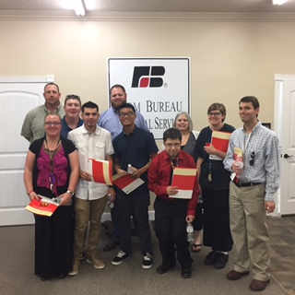
Second year and beyond
Students have the opportunity to return to our program for another year to earn a second certificate in another vocational area and receive advanced instruction in the core classes.
Students also have the opportunity to return to our program for a third and fourth year to earn more certificates in other vocational areas and receive advanced instruction.

Slide 11
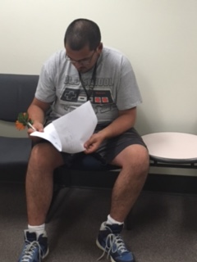
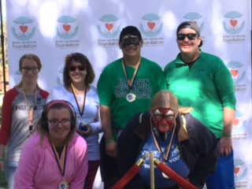
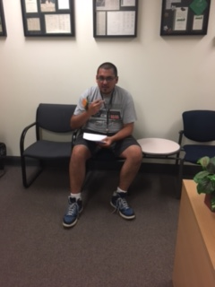
Entrance and Admission
All of our entrance requirements can be found in our brochure, application packet, and/or online.
All applications are reviewed by an acceptance committee to ensure a student possesses the basic skills necessary for our program and for the technical area in which they would like to study.
Applications will be accepted and reviewed on a rolling admission until May 01, 2021. Those interested in our program are encouraged to apply as soon as possible as class sizes are limited.

Slide 12
Entrance Requirements

Slide 13
Program Cost and Financial Aid
The 3 semester, 11 month, 50 credit hour Occupational Training program ranges from $19,000 to $22,000 all inclusive (tuition/fees, books, room and board, meal plan, uniforms, and bus pass).
Students are encouraged to contact Texas Workforce Commission (TWC) or Health & Human Services Commission (HHSC) as the Department of Assistive and Rehabilitative Services (DARS)-Texas, has referred the services support to these specific departments, or the Division of Vocational Rehabilitation (DVR)-New Mexico, and complete the FAFSA for financial assistance.

Slide 14
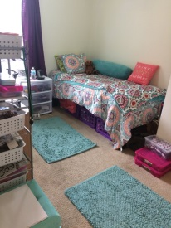
Dorm and apartment life
Covid-19 restrictions have limited all Special Services students to Building 1, third floor.
Students have their own room.
Have access to a common area and full kitchen on the third level
Have 3 washers and dryers available for use.
No opposite sex visitation is allowed within all dorms and apartments.

Slide 15
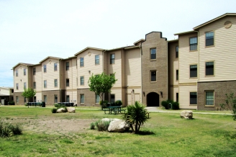
Sierra vista village
The University does not own or operate Sierra Vista Village (SVV). Sierra Vista Village is owned by American Campus Communities (ACC). However, Special Services administration works closely with the SVV staff to help ensure all the needs of our students are met.

Slide 16
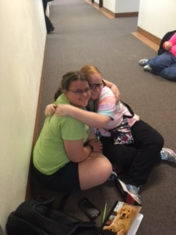
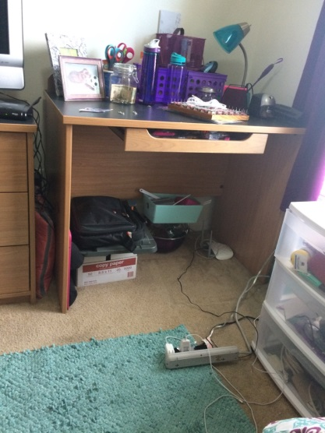
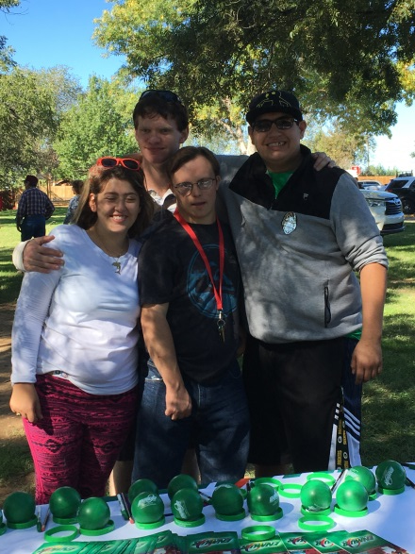
College life
Weekend and evening activities and clubs are available through Sierra Vista Village for residents.
Special Services sponsors activities and events throughout the year.
Special Olympics opportunities are available through the Roswell chapter.

Slide 17
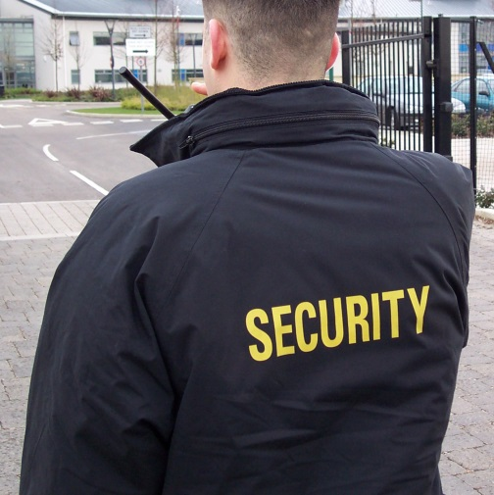
Safety and Security
24-hour Campus Security.
All Special Services staff are available during their office hours or by appointment if needed.
Special Services administration is on call 24 hours a day.
Dorm support is provided to students on a nightly basis.

Slide 18
Health Services
La Casa Family Health Center operates a practice near campus to provide students an option for their basic medical and dental needs.
Mental health supports are available in the community at the students’ expense.
Students must be able to self-medicate without assistance; follow directions from nurse, doctor, and/or pharmacy; manage medical and psychological issues appropriately; and take the appropriate medicine at the correct time.

Slide 19
Transportation
Public transportation is available and students purchase a bus pass as part of the total program fees. With initial training, students are expected to utilize the public transportation system to get from school to the community.
Special Services staff will only transport students for Special Services sponsored activities and school internships if outside the bus route.
Roswell has a small airport called Roswell International Air Center (RIAC). Please plan accordingly.

Slide 20
To request information
Brianna Bitner (Coordinator) 575-624-7286
brianna.bitner@roswell.enmu.edu
Rebecca Cobos (Director) 575-624-7289
rebecca.cobos@roswell.enmu.edu
Eastern New Mexico University Roswell
Special Services
PO Box 6000
Roswell, NM 88202

